Slide 1
Year 6 PSHE

Slide 2
Changing Me Lesson Overview Term 6
Self and Body Image
Puberty
Conception to Birth
Boyfriends and Girlfriends
Real Self and Ideal Self
The Year Ahead

Slide 3
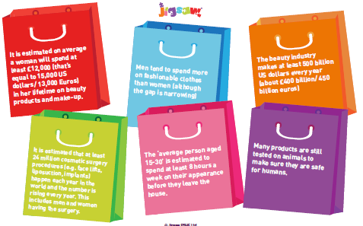
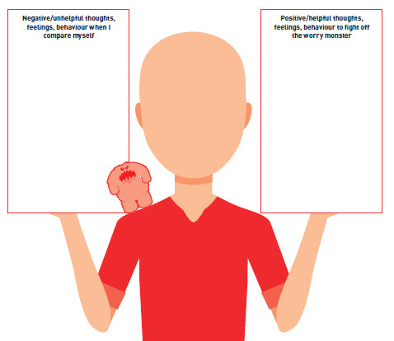
Lesson 1- Self and Body Image
This lesson allows for a lot of open discussion about image – perceived and actual image.
Children learn some facts about the fashion industry and discuss why they think people like to spend so much time and money on fashion. A discuss about peer pressure also feeds in here.
Children are then split in to gender groups and within their groups are asked to draw and label the ‘perfect’ man/woman. This then feeds the discussion about where these ideas come from and whether they are fair and realistic ideas.
Children then explore ‘unhelpful thoughts’; ‘unhelpful behaviours’ and ‘unhelpful feelings’ relating to self image and work together to change these in to positive thoughts, feelings and behaviours for ourselves.

Slide 4
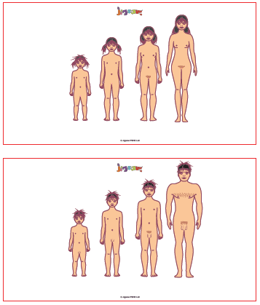
Lesson 2 – Puberty
In this lesson children begin by recapping their knowledge and understanding about puberty. They play fun games to explore the changes which happen to girls; boys; both.
They also explore the truths and myths around puberty.
Children are then split in to same sex groups to allow them to talk openly about the physical and emotional changes which occur during puberty. A male teacher will support or deliver this part of the session with the boys.
There are many opportunities to raise questions and concerns either publicly or anonymously.
Children also discuss given worries that children may have and a safe space is provided for them to talk these worries through.

Slide 5
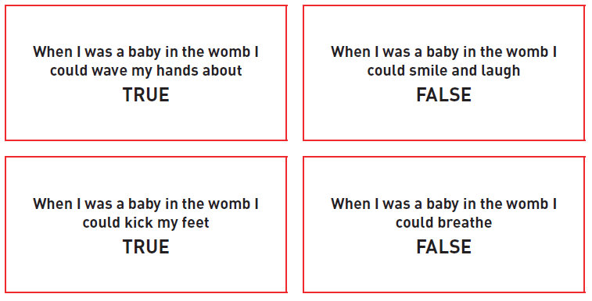
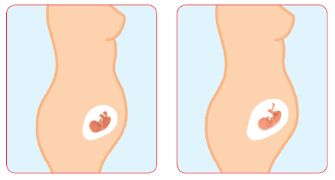
Lesson 3 – Conception to Birth
This is a SEX EDUCATION lesson. Parents have a right to withdraw their child from this lesson.
To start this lesson, children look at statements about what a baby can or can’t do in the womb. This is to focus the children on the incredible development of babies which we have no memory of.
Children also review the stages of foetal development in the womb.

Slide 6

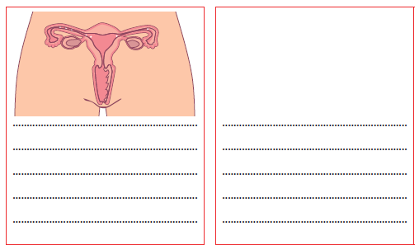
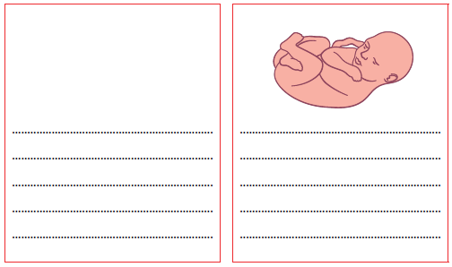
Lesson 3 – Conception to Birth continued
Children work together to review the stages from conception to birth by creating their own resource cards. They can decide which stages they feel are significant.
This allows them to apply their knowledge and understanding of puberty and conception from previous years to help them.
Where they are unsure, they are given a script to support them along with a word bank of scientific vocabulary relating to the process and journey.

Slide 7
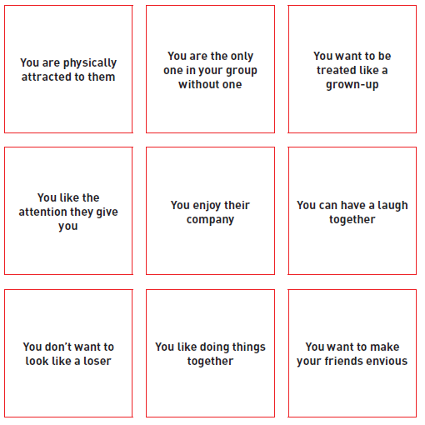
Lesson 4 – Boyfriends and Girlfriends
In this lesson, children explore the difference between having male and female friends and having a boyfriend or girlfriend. They learn that the difference is usually that there is a physical or romantic attraction and that is what makes these relationships special.
In groups children work together to order the cards to answer the statement – ‘You might want a boyfriend/girlfriend because..’. Children order them ‘most important’ to ‘least important’

Slide 8
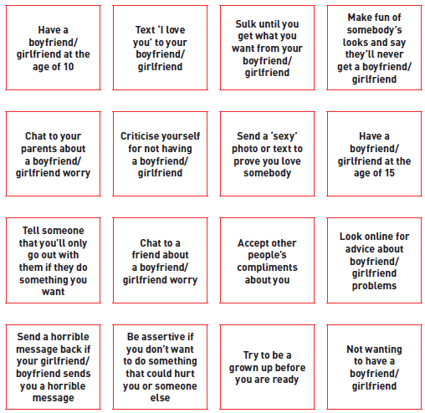
Lesson 4 – Boyfriends and Girlfriends continued
The next part of the lesson looks at ‘respect’ and ‘personal choice’. Children listen to a scenario of a young couple, which starts of well, then one of them wants to kiss, then it moves on to sending an image of them half dressed via text.
The scenario opens up the discussion of what were the ‘right’ and ‘wrong’ behaviours, as well as exploring pressures from both parties.
Children are told about the legal implications when it comes to sending ‘sexy’ images and of passing these on.
Children then sort these cards – ‘Should I?’ ‘Shouldn’t I?’ and discuss how they feel about them.
The lesson ends with a review of respectful relationships and each persons right to be respected.

Slide 9
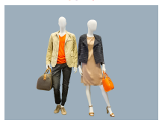



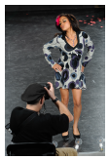
Lesson 5 – Real Self and Ideal Self
This lesson focuses on the importance of positive self esteem.
Children look at ‘ideal body’ images as a catalyst for discussion, and how these and other images they have come across make them feel.
Children discuss ‘body talk’ both negative and positive and how this can impact on our self esteem.
In same sex groups children explore words that they would use to describe the ‘ideal image’, then they explore individually the words that they would use to describe their ‘real self’ and discuss the difference between the two.

Slide 10
Lesson 6 – The Year Ahead
This lesson focuses on the children transitioning to secondary school and exploring the hopes and worries that they may have.
Children work together to support each other to overcome or manage their worries.
It is also a time for children to reflect upon their time at Primary school and their achievements, as well as acknowledging the tools that the children have acquired which will help them in their new school.

Slide 11
Thank you for coming to our meeting

