Slide 1
Year 5 PSHE

Slide 2
Changing Me Lesson Overview Term 6
Self and Body Image
Puberty for Girls
Puberty for Boys
Conception (Sex Education)
Looking Ahead – becoming a teenager
Looking Ahead – moving in to Year 6

Slide 3
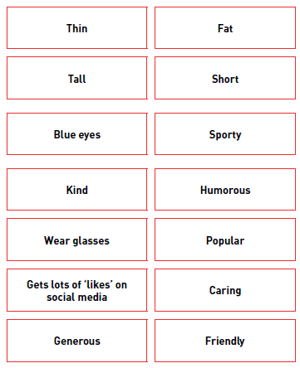
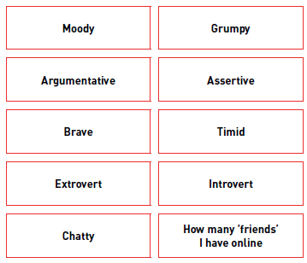
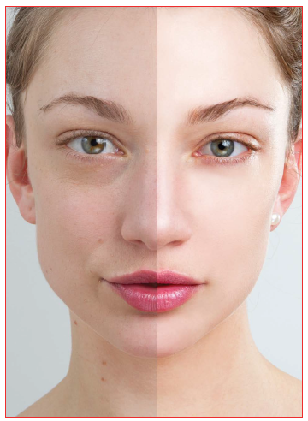
Lesson 1- Self and Body Image
Through the use of self image cards, children decide what they believe to be a positive or negative aspect of it. There are no right or wrong answers.
Discussions around images online of people. How these can sometimes have been altered using filters. Why these images can be harmful to our personal wellbeing.
Using affirmations as a technique to transform negative self image in to positive self image, which in term increase self-esteem.
People are like a chest of drawers. The top drawers all full of things we are happy to share with everyone. The middle drawers are things we are little more cautious about sharing. The bottom drawers contain private information that we don’t wish to share.
Children explore things about themselves that they like and dislike, then using positive affirmation, look at the negative things and re-affirm them in to positive one.

Slide 4
Lesson 2 – Puberty in Girls
Looking at what makes them embarrassed. How do these things make them feel and behave? How can you make yourself feel less embarrassed or show your embarrassment less?
Begin to discuss the embarrassment when thinking and talking about puberty. Think about the reasons why we can feel embarrassed about some of the changes and experiences of puberty: because they are private and personal, they affect parts of the body we don’t usually talk about, they affect who we are in a fundamental way. This is an opportunity to reassure the children and remind them that the changes and the feelings they experience are completely natural and part of a life cycle that affects everyone: the changes are natural, and a little bit of worrying is natural too.

Slide 5
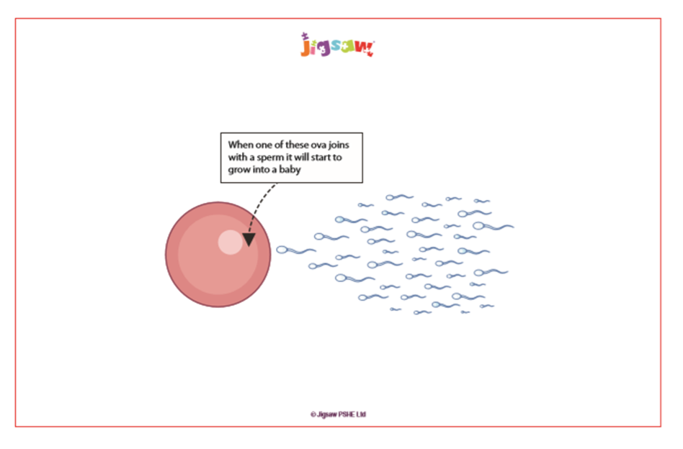
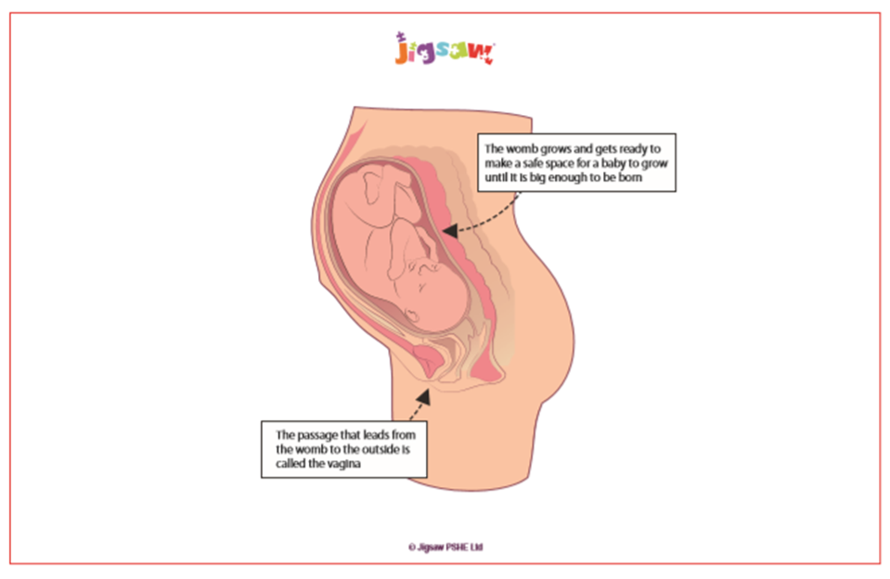
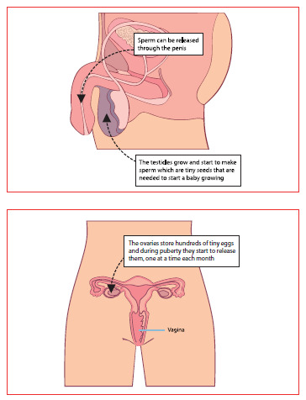
Lesson 2 – Puberty in Girls continued
Children recap on their knowledge (from Year 3) of what ingredients make a baby – sperm and ovum.
Through images, children learn about the development of the female reproductive system

Slide 6
Lesson 2 – Puberty in Girls continued
Teachers then teach the children how the female body prepares to have a baby and how this results in menstruation/monthly periods. A script is used for this part of the lesson for teachers to follow. Here are some samples of the script:
  When a girl’s body reaches puberty the eggs (ova) in her ovaries start to mature. Puberty can happen any time between the ages of 10 and 14, but it is different for everyone so we shouldn’t worry if we start puberty earlier or later than our friends.
  If the egg (ovum) meets a sperm, the egg will be fertilised and a baby will start to grow. This is called conception. The baby at this point is called an embryo.
  If an egg is fertilised it settles into this soft lining of the womb/uterus and the embryo develops into a baby.
  If an egg (ovum) isn’t fertilised by a sperm, then the lining of the womb isn’t needed. The lining breaks up and the spare blood it contains passes out of the woman’s body through her vagina and vulva. This is what is called ‘having a period’.

Slide 7
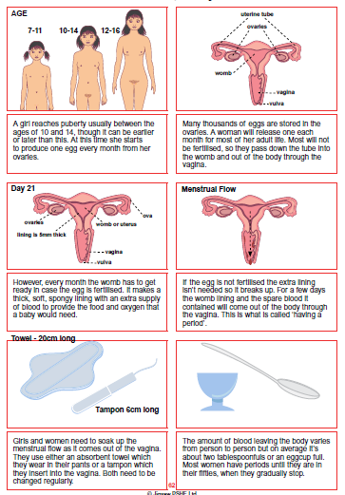
Lesson 2 – Puberty in Girls continued
Children are then shown sanitary products and an explanation of how they are used.
Children are then split in to gender groups to do a carousel of activities around the menstruation cycle. There are opportunities for children to ask questions openly and share their worries and concerns.
Groups come back together and there is another opportunity to discuss any concerns and worries together.
Children are introduced to the questions box, which will be a way for them to continue to talk about and ask questions about this lesson as well as questions about growing up.

Slide 8
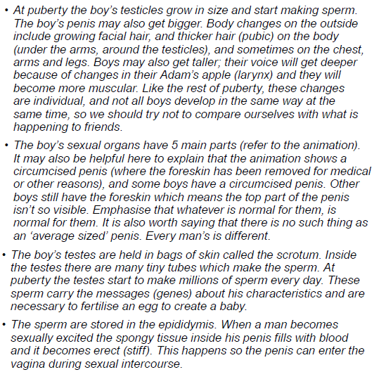
Lesson 3 – Puberty in Boys
To start this lesson, children explore the answers to different questions about the changes to boys and girls. Does one gender have it easier then the other? This opens up the lesson to a free discuss about the impact and effects of puberty on both genders.
Children review their knowledge of the male reproductive system and the changes within the male body during puberty.
An animation is used as a visual aid (show animation). A script is used alongside the animation. Here is an extract from the script:

Slide 9
Lesson 3 – Puberty in Boys
To start this lesson, children explore the answers to different questions about the changes to boys and girls. Does one gender have it easier then the other? This opens up the lesson to a free discuss about the impact and effects of puberty on both genders.
Children review their knowledge of the male reproductive system and the changes within the male body during puberty.
An animation is used as a visual aid (show animation). A script is used alongside the animation. Here is an extract from the script:

Slide 10
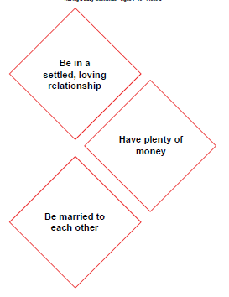
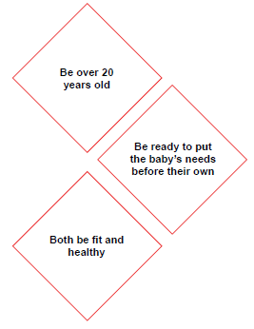
Lesson 4 – Conception
This is a SEX EDUCATION lesson. Parents have a right to withdraw their child from this lesson.
To start this lesson, children play a matching game. They pair up different relationships: boyfriend/girlfriend; mother/father. Cards can be paired in any way so they could be paired girlfriend/girlfriend. Children then have to sort them in to different relationship groups: family; peers; working; attraction. This allows children to see that we have many different types of relationships.
This moves on to discuss physical relationships and the questions these couples should ask themselves before having a baby. Children use statement cards and have to priorities them according to importance. This part of the lesson allows children to understand that there are many considerations when thinking about having a baby.

Slide 11
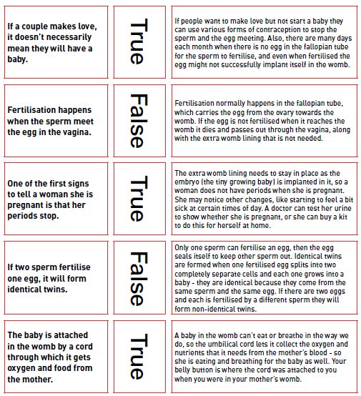
Lesson 4 – Conception continued
Children are introduced to the word ‘conception’ – the moment when a new life begins. Children review their knowledge and understanding of the male and female reproduction system .
Children learn that for some conception occurs through sexual intercourse, but there are other ways for conception to occur such as IVF.
They explore ‘true’ and ‘false’ statements around conception. Examples here:

Slide 12
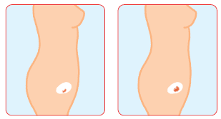
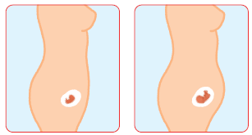
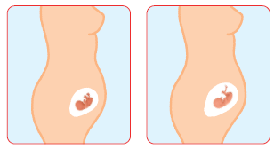
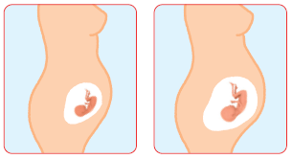
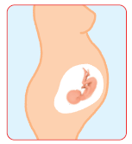
Lesson 4 – Conception continued
Children then review the stages of foetal growth within the womb.

Slide 13
Lesson 5 – Becoming a Teenager
Children look at various teenage magazine and discuss the perceptions that they give for how teenagers are.
Children sort through pages of the magazine and decide which show reality and which don’t.
Children have a discussion about the responsibilities that becoming a teenager brings. This will include making children aware that the legal age of consent is 16.
Children create a birthday card for a 15 year old about to turn 16. Inside they write some advice for them based on what they have learnt this term.

Slide 14
Lesson 6 – Moving In To Year 6
This lesson focuses on the transition to Year 6. It’s an opportunity for children to discuss their concerns and excitements for the year ahead.
It is also a time to reflect upon their time in Year 5 and to share their highs and lows.

Slide 15
Thank you for coming to our meeting

