Slide 1
Year 4 PSHE

Slide 2
Changing Me Lesson Overview Term 6
Unique Me
Having a baby
Girls and Puberty
Circles of Change
Accepting Change
Looking ahead

Slide 3
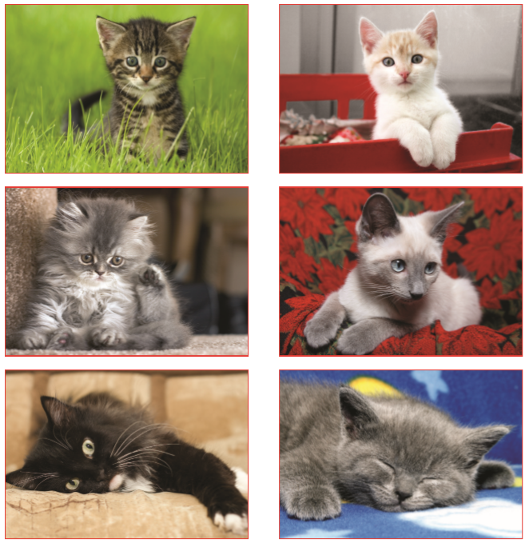
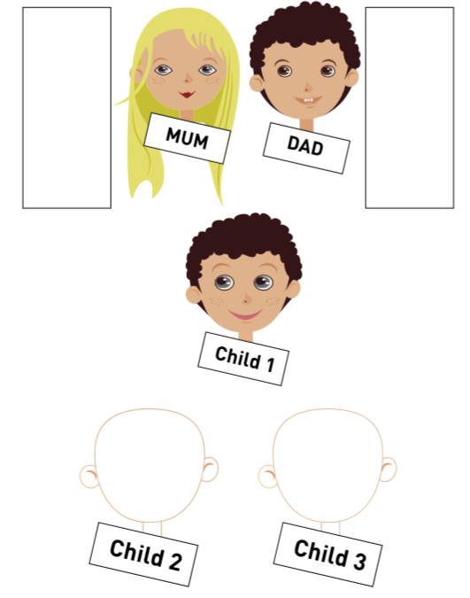
Lesson 1- Unique me
Describing themselves and others with adjectives e.g. crafty, clever, impulsive, kind.
The children participate in an activity to sort kittens into family groups with the mother cats. They are then done in a very random way. This activity allows the children to explore that some characteristics are clearly from our parents and others are unique to themselves.
Brief discussion about genes. The teacher might show a picture of themselves with their own parents.
The final activity is looking at a cartoon family and the characteristics the mother and father have and then thinking about the characteristics the children might inherit.
It is briefly mentioned that we get half our genes from our bity other and half from our birth father and this happens when the mothers egg and fathers sperm meet. The children will be offered an opportunity to ask anonymous questions in a post box.

Slide 4
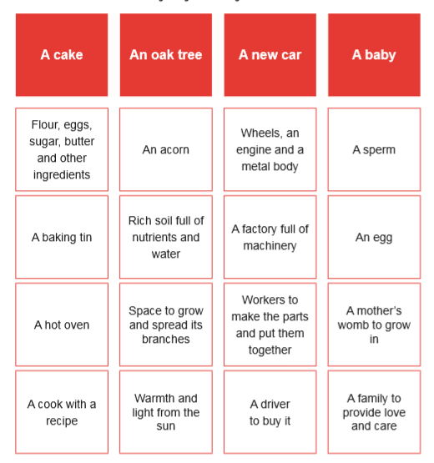
Lesson 2 – Having a baby
The children will play a making things game, they each have
a card and they have to find connections. They will end up in
groups to make a car, baby, cake and oak tree.
The class will discussion that in order to make anything ingredients are needed. Children will discuss the following questions:
  Why would people choose to have babies?
  What would be difficult about having a baby?
  Discussion will show that having a baby is both a great joy and a big responsibility, and that is why many people wait until they have a loving and stable relationship in which to care for the baby. It is a natural human instinct to want babies; if not, none of us would be here! It is a choice people make, and some people choose not to.

Slide 5
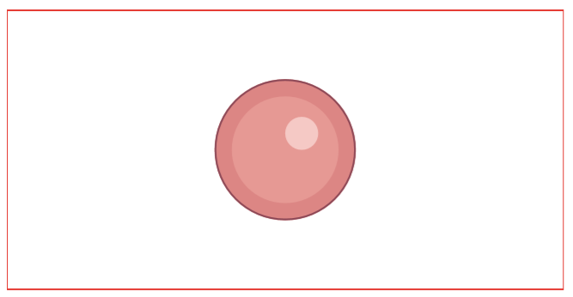
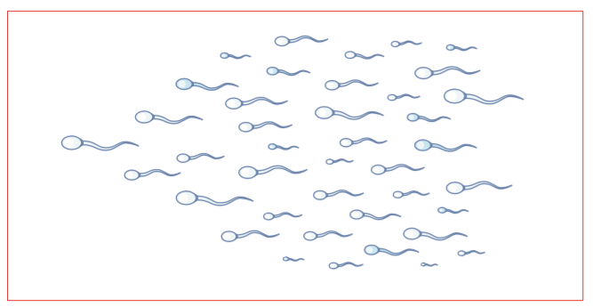
Lesson 2 – Having a baby - Continued
The class will discuss the main ingredients that are needed to make a baby.
The sperm is full of messages contained in genes about what the father is like and the egg is full of genes about what the mother is like.

Slide 6
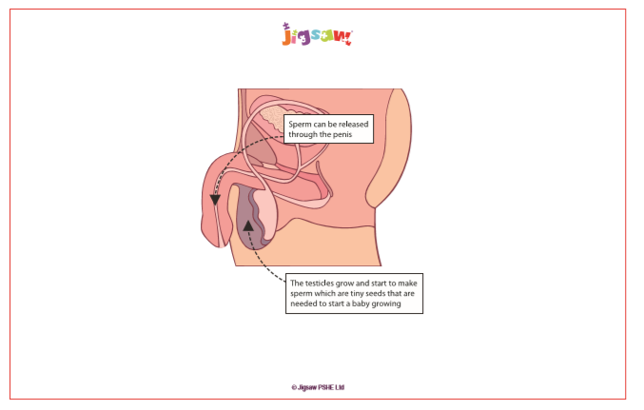
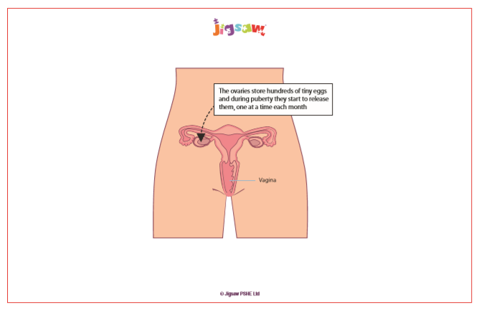
Lesson 2 – Having a baby - Continued
The following images are used to discuss where the sperm and egg come from inside the body.
This will be told to the class in an age appropriate way.
This is an example of how it might be phrased.
It’s amazing how a baby starts to grow when a man’s sperm and a woman’s ovum meet and join together. This can happen when a grownup man and woman share an especially close and loving embrace which allows the sperm to be released through the penis into the vagina. People refer to this as ‘making love’ or ‘having sex’ or sexual intercourse. It’s an intimate, loving and very private part of a grown-up relationship. From the vagina, the sperm can swim through the womb/ uterus into the tubes that lead from the ovaries. If they meet an egg/ ovum there, one of them may ‘fertilise’ it - join with it so that it starts growing into a baby. This is called conception. The fertilised egg settles into the soft lining of the mother’s womb, where it will grow until it is big enough to be born 40 weeks/(9 months). The baby will get half of its genes from the mother’s egg/ovum and half its genes from the father’s sperm.
Notes:
Caucasian skin tone has been used on most of the diagrams. This is for clarity of image. However, teachers should also reinforce that different skin tones exist, and that private parts will also reflect these skin tones. e.g. if we have dark skin then our private parts will also be dark.

Slide 7
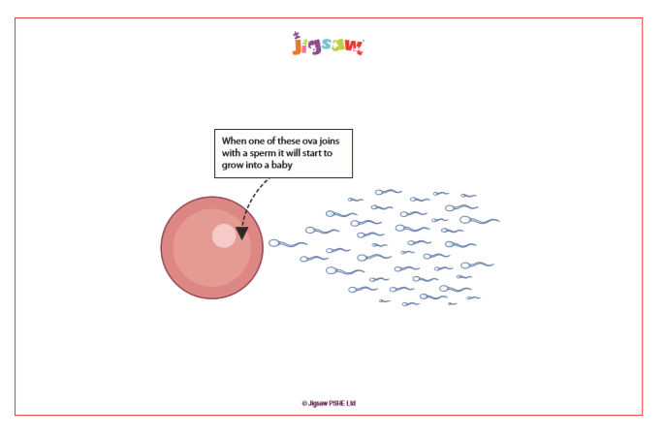
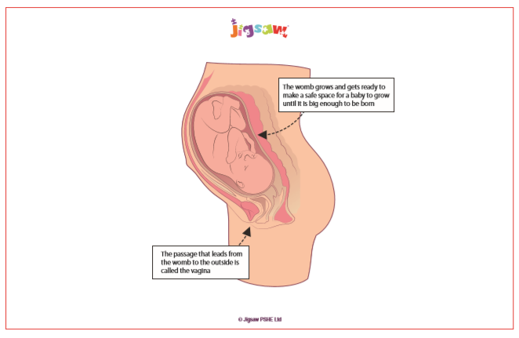
Lesson 2 – Having a baby - Continued
How conception happens is part of the Sex Education curriculum and parents can request for their child to be withdrawn from this part of the lesson.

Slide 8
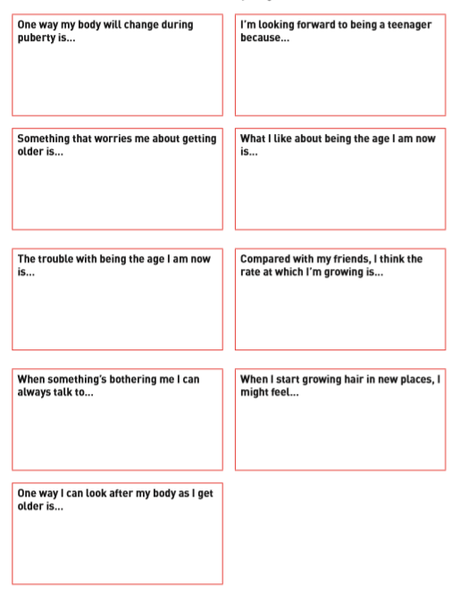
Lesson 3 – Girls and puberty
This lesson begins with discussing the meaning of puberty.
The discussion will move on to ‘How do I feel about puberty?’ Using the sentence starters they will complete the sentences.
A bag of items will be shared with the class e.g: deodorant (boy and girls products), spot cream, hair gel, comb, diary, teenage magazine, smart phone, iPad, bra, shaving foam, sanitary towel, tampon, pant liner, etc.
The word ‘menstruation’ (literally meaning a monthly event) will be introduced and explain this is a special part of puberty that affects girls/ people who are born female.

Slide 9
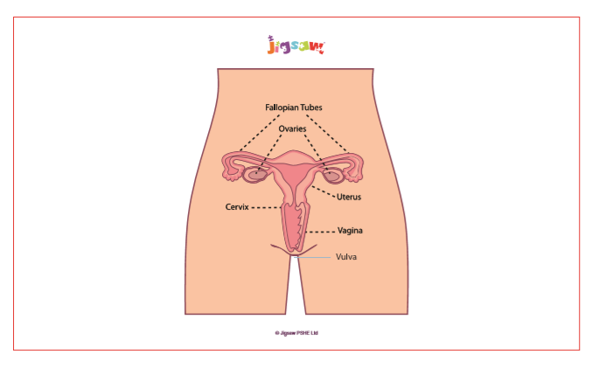
Lesson 3 – Girls and puberty
The process of menstruation will be discussed in an age appropriate way.

Slide 10
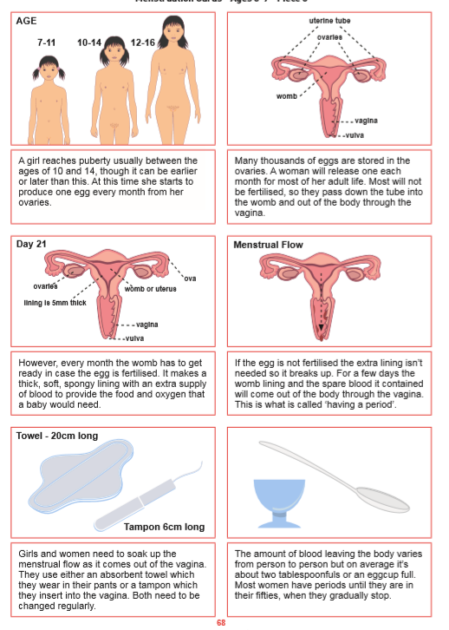
Lesson 3 – Girls and puberty
Children will be given the opportunity to order the pictures or match up the captions.
There will be an opportunity to discuss any worries they might have and also put anonymous questions in a box.

Slide 11
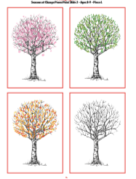
Lesson 4 – Circles of choice
Looking at four pictures of a tree in different seasons, they will discuss the following questions.
  What started the process of change for the tree?
  What happened in each stage of the change?
  Did the tree have any control over the changes that were happening to it?
  Discuss the changes that have happened to the tree and how much control the tree had.
  It will be highlighted that change is a natural part of life and something we will all experience. Some change we can control and others we cannot.
  We can do things to help us prepare for change and manage it better.

Slide 12
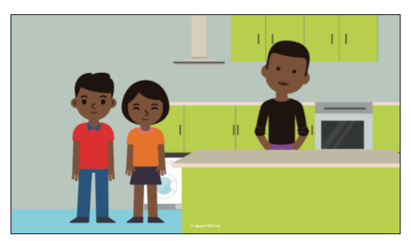
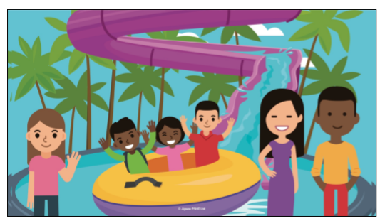
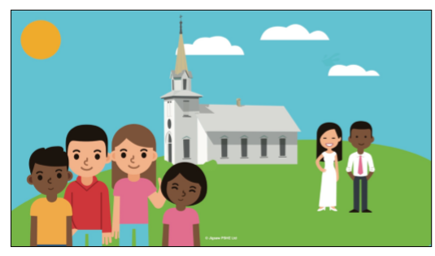
Lesson 4 – Circles of choice
A story will be shared with the class about Sophie and Levi about their dad meeting anew partner and wanting to get married. The children will be asked to identify what happens in the story to manage the change and help the children cope. The children will think about what helped them to manage the change.
Show the children the Circles of Change PowerPoint slide/ template and make links between the story and the five stages in the model to reinforce the process.

Slide 13
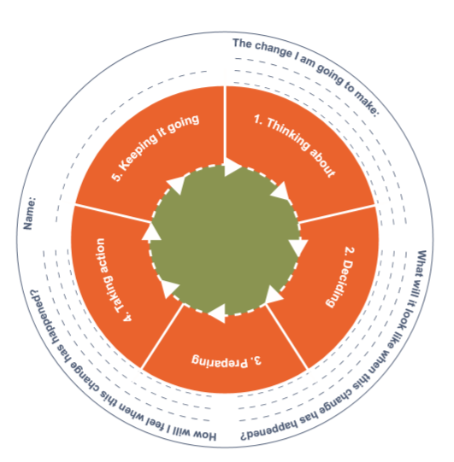
Lesson 4 - Circles of choice
The class will be shown the Circles of Change PowerPoint and links will be made with the story and the five stages involved.
Children will make their own Circle of Change.

Slide 14
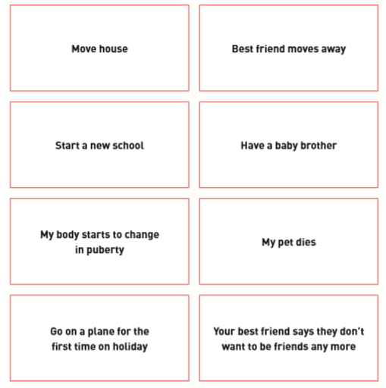
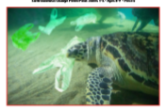
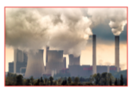
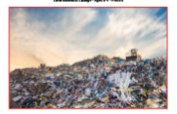
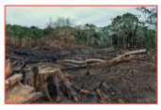
Lesson 5 – Accepting Change
This lesson begins with the children thinking about different scenarios and how they might feel if they were in those situations.
Look at pictures of environmental change. Children will be asked to think about the pictures and discuss their ideas in pairs or small groups.
  • Why do these changes happen?
  • Do human beings have complete control over these changes? Ask for feedback and their ideas.
  They will discuss how humans influence nature for good and bad, but humans don’t have complete control.
In the final activity children will think about changes that have happened in their own lives and whether they had control or not.

Slide 15
Lesson 6 – Looking ahead
During this final lesson children will be given the opportunity to reflect on what they have learnt.
They will have the opportunity to think about changes that might happen to them in the next school year.

Slide 16
Thank you for coming to this meeting.

