Slide 1
Year 2 PSHE

Slide 2
Changing Me Lesson Overview Term 6
Life Cycles in Nature
Growing From Young to Old
The Changing Me
Boy’s and Girl’s Bodies
Assertiveness
Looking ahead

Slide 3
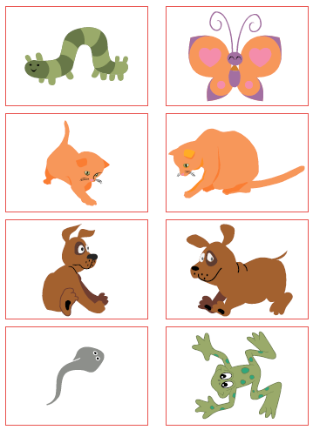
Lesson 1- Life Cycles in Nature
This lesson introduces the children to life cycles within nature and talking about the changes from baby to adult among different animals.
Children work in pairs to create a life cycle for one of the animals – butterfly; frog; baby
Then they look at pairing baby to adults.

Slide 4
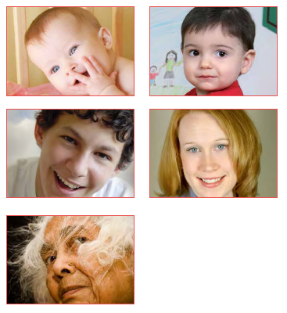
Lesson 2 – Growing From Young to Old
This lesson looks at how we change as we become older.
Children have opportunities to think about how they have changed, as well as how older people that they know would have changed.
Children create a timeline of changes that they have experienced and think about the changes which are yet to come.

Slide 5
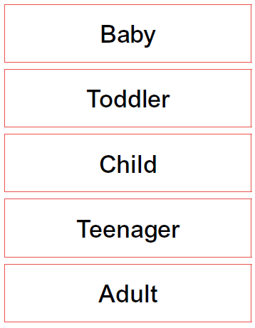
Lesson 3 – Changing Me
In this lesson children begin to think about how their bodies have changed since they were babies.
Children are made aware that change takes time and some children may grow quicker than others.
They learn the names given to them at different points in their life: baby; toddler; child; teenager; adult.
Children begin to think about the different things which could be associated with each group, such as, dummy, lego, house keys, bank card
Children create their own timeline for themselves which includes things which they are proud of, as well as, including what they’d like to achieve as a teenager and an adult.

Slide 6
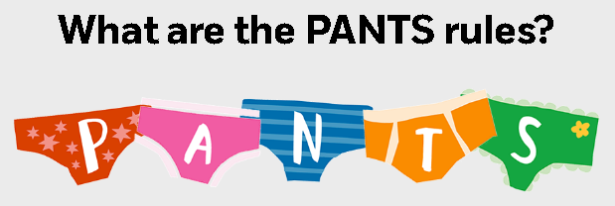
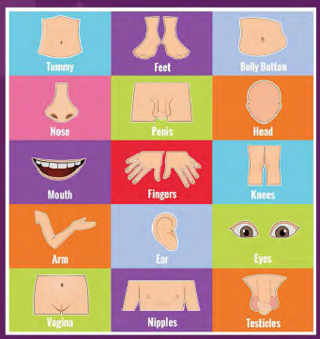
Lesson 4 – Boy’s and Girl’s Bodies
During this lesson children begin to recognise the physical differences between boys and girls. They also learn to use the correct names for parts of the body and appreciate that some parts are private.
This lesson is taught alongside the NSPCC Pants programme.
The first part of the lesson involves the children thinking and talking about the differences between the things boys and girls do.
Children are then introduce to body part pictures which they are asked to place on a body outline. This is an opportunity to talk about the physical differences between girls and boys.
Using pieces of children’s clothing, children are taught the difference between clothes that keep us warm, to those that keep those private parts of body private and hidden.

Slide 7
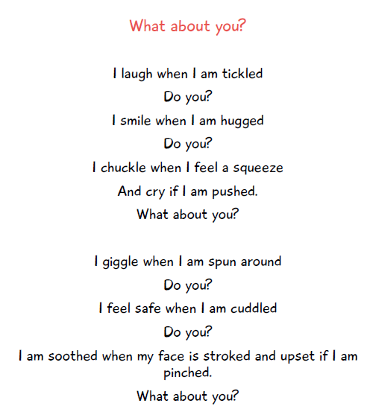
Lesson 5 – Assertiveness
This lesson is all about teaching the children that it is okay to say ‘no’.
The lesson focuses on touch and the different types of touch people might like, such as, holding hands, hugs, being rubbed. We use this poem as a way in to talking about touch.
Children will learn that not everyone likes to be touched or that they only like to be touched by certain people, or in a certain way.
Children have opportunities to explore their feelings on being touched and how to ask someone not to touch them.

Slide 8
Lesson 6 – Looking ahead
This lesson is an opportunity for the children to reflect back on their time in Year 2, what they are proud of. What were their greatest achievements?
It is also an opportunity for the children to look ahead and to think about how they feel about going in to Year 3. A time to share any worries and concerns that they may have as well.
Children also share their hopes for their next school year.

Slide 9
Thank you for attending this meeting.

