Slide 1
Year 1 PSHE

Slide 2
Changing Me Lesson Overview Term 6
Life Cycles
Changing Me
My Changing Body
Boys and Girls Bodies
Learning and Growing
Coping with Changes

Slide 3
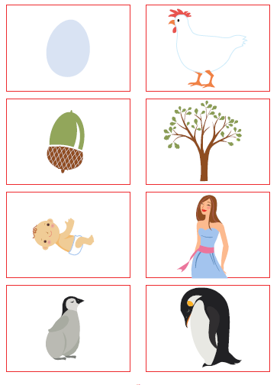
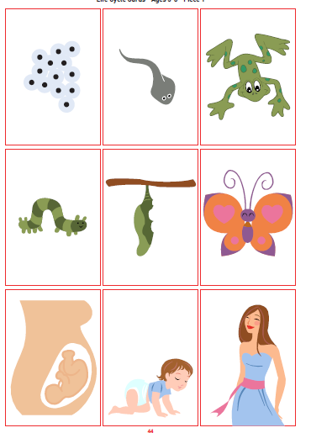
Lesson 1- Life Cycles
The lesson will begin with a warm up activity. The children will each be given a card and they will have to find their partner and discuss the changes that have happened to make the baby into an adult.
The children will look at the life cycle of a frog.
They will be told that ‘life cycle’ means growing from birth to adult.
They will then look at a set of photos of their teacher at different stages in their lives, e.g. baby, teenager, adult etc.
In groups they will be given a set of cards from a life cycle to order correctly.

Slide 4
Lesson 2 – Changing Me
This lesson begins with the children playing a change game, they will be asked to move around the room as an animal e.g. mouse (tip toes, squeaking) the teacher will say ‘change – monkey’ and the children will move as a monkey and so on.
Children will then think about things they can do now that they couldn’t do as a baby.
Children will work in groups to sequence life cycles of different things. This will reinforce the idea that every living things has a life cycle and grows from young/baby to fully grown/adult.
There will also be another opportunity to discuss how the children have changed since they were babies.
Children might make a little book about how they have changed.

Slide 5
Lesson 3 – My Changing Body
The warm up is a game similar to Simon says. Jigsaw Jack says………
The children will be shown a picture f the teacher as a baby. The children should guess who it is? Why was it hard to know?
Children will have been invited to bring in a picture of them prior to this lesson. The children will look at the photos of the class as babies and guess who each picture is.
The focus of the learning is that we are all changing all the time but we are al still us.

Slide 6
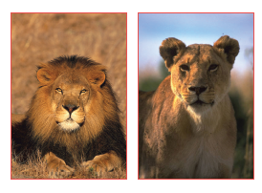
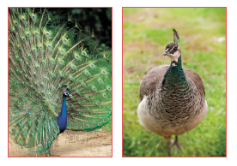
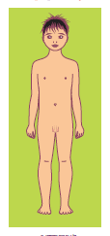
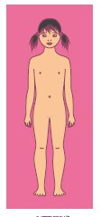
Lesson 4 – Boys and Girls Bodies
The warm up for this lesson is an activity where each child is invited to share their favourite food, this is to highlight the similarities and differences within the class.
The class will look at slides o different animals and will be asked to identify which is female and which is male. How do they know?
The children will be asked to discuss ways in which boys and girls are different. One way that will be highlighted is through the different private body parts.
Using the pictures of a girl and a boy the children will be invited to name the different body parts. Penis, testicles, vagina and vulva will be introduced.
We will use the term ‘private parts’ and we will reinforce that private means special and important not guilty and dirty.
They will be told that our private parts are special and no one should do anything to them that hurts them or makes them feel scared.
Notes:
Caucasian skin tone has been used on most of the diagrams. This is for clarity of image. However, teachers should also reinforce that different skin tones exist, and that private parts will also reflect these skin tones. e.g. if we have dark skin then our private parts will also be dark.

Slide 7
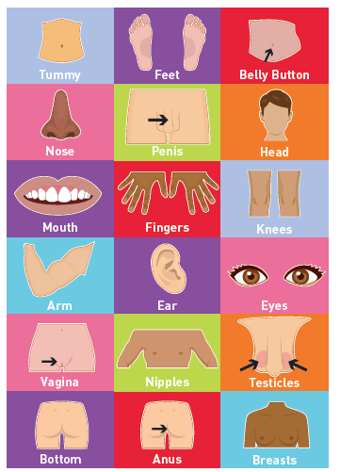
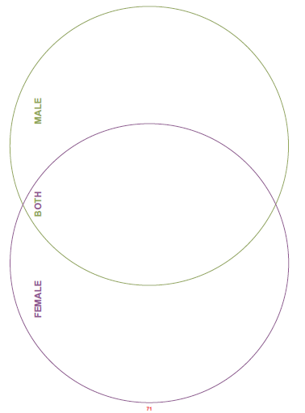
Lesson 4 – Boys and Girls Bodies
As a class we will look at the pictures and sort them with two overlapping circles for male, female and both.
We will also discuss when it is and isn’t ok to talk about private parts.

Slide 8
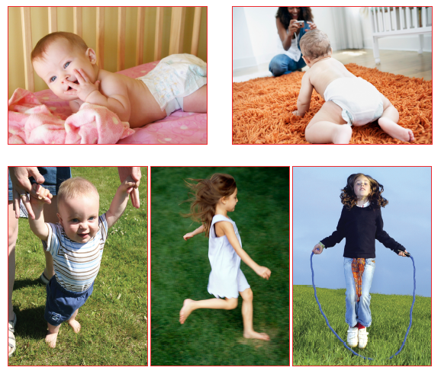
Lesson 5 – Learning and Growing
Children will look at the pictures of a baby, toddler and child doing different things. They will put them in order. We will discuss that as we physically grow we also learn to do new things.
As a class we will fill the petals on a flower with the new things learnt in the picture and then think about things we have learnt. They will learn that however old we are we are still growing and learning.
The children will then curl up in ball and they will pretend to grow like a flower each time the teacher says something that applies to them e.g. learnt to walk.

Slide 9
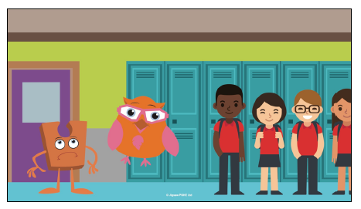
Lesson 6 – Coping with Change
During this lesson the children will be read a story all about Jigsaw jack (the character and cuddly toy that is in the classroom and linked to jigsaw). It is all about him feeling sad that the class will be moving up and he will be left behind. It looks at how he copes with these feelings and changes and how the rest of the class are feeling too.
The teacher will then share objects that link to big changes in their lives e.g. a school jumper would represent starting school.
For each change they will discuss how it might make them feel and how they could cope with those feelings.

Slide 10
Thank you for coming to this meeting.

