Slide 1

St Mary Redcliffe Primary School
RSHE Parent/Carer’s Meeting

Slide 2
Meeting Content:
Why the Curriculum is Changing
Why RSHE at SMRP is Important
Statutory Guidelines
Jigsaw Curriculum an overview
How we teach the:
  Relationships Curriculum
  Health Curriculum
  Sex Curriculum
Rights of a parent/carer
Commonly asked questions
What happens next?

Slide 3

The PSHE curriculum is a very broad subject with many topics, including citizenship; economic awareness; goals and aspirations.
Relationships, Health and Sex education are also important strands within this encompassing curriculum.
Notes:
Through this meeting and presentation we aim to highlight the governance and changes in the delivery of the Relationships, Health and Sex education curriculum, as well as share with you some of the material that is used in the delivery of these lesson.

Slide 4
Why is the Curriculum Changing?
‘Today’s children and young people are growing up in an increasingly complex world and living their lives seamlessly on and offline….children and young people need to know how to be safe and healthy, and how to manage their academic, personal and social lives in a positive way’
DfE Guidance on Relationships Education, Sex Education and Health Education 2019
Safeguarding children is at the heart of SMRP’s Relationship, Health and Sex Education curriculum.

Slide 5
Why is the Curriculum Changing?
In light of this, legislation was changed to ensure:
Relationships and Health Education compulsory for all pupils receiving primary education.
Notes:
The Relationships Education, Relationships and Sex Education and Health Education (England) Regulations 2019, made under sections 34 and 35 of the Children and Social Work Act 2017, made

Slide 6
Why is the curriculum changing?
In addition the Equality Act of 2010 protects every British citizen from discrimination because of the following protected characteristics:
Part of the Equality ‘duty’ is to teach children about their rights and responsibilities; acceptance; empathy and understanding of others.
Age Disability Race Religion or belief Sex
Pregnancy and maternity Sexual orientation
Gender reassignment Marriage and civil partnership
Notes:
This act requires schools to eliminate discrimination; advance equality of opportunity; and foster good relationships. By doing so, the Equality Act encourages schools to meet the diverse needs of children and to improve outcomes for all pupils regardless of background.
Relationships, Sex and Health Education at SMRP
will ensure that all children are valued under this act.

Slide 7
Why RSHE at SMRP is Important
At SMRP we believe that high quality Relationship, Sex and Health education helps to create a safe school community in which children can:
Grow, learn, and develop positive, healthy behaviours for life.
Prepares them for the challenges, opportunities and responsibilities of adult life.
A comprehensive RSHE curriculum can have a positive impact on children’s health and wellbeing and their ability to achieve.
Notes:
We are fully committed to providing a RSHE curriculum that not only meets the needs of all our children but also keeps our children safe and protected, especially from the tremendous pace in which technology is evolving.
Through our RSHE curriculum we believe that all children should learn and understand how to build and foster healthy positive relationships as well as value and respect all religions and beliefs within the diverse community that we live in.

Slide 8
Statutory Guidelines for Teaching RSHE
Relationships and Health education will be compulsory for ALL primary aged pupils from September 2020.
Schools are encouraged to provide a sex education curriculum that meets the needs of their pupils.

Slide 9
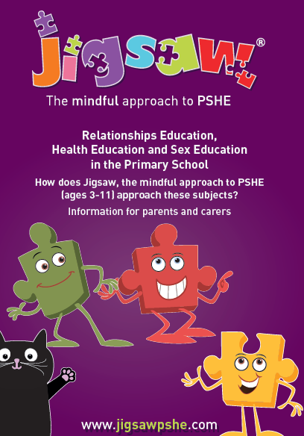
Jigsaw Overview
At SMRP we have and will continue to use the Jigsaw scheme of work.
Notes:
Through this we teach our Personal, Social, Health and Emotional curriculum as well as our Relationships and Sex curriculum.
Jigsaw is dividing in to 6 strands and each strand is taught once a year.

Slide 10
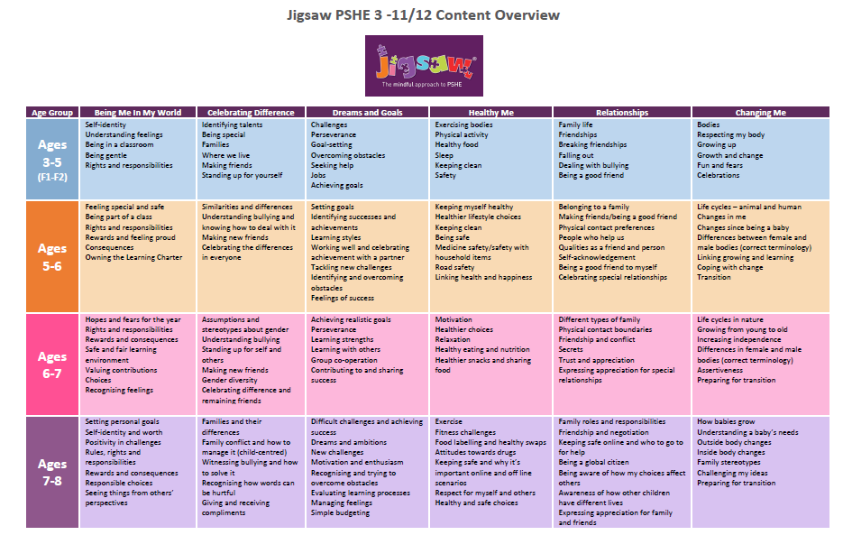

Slide 11
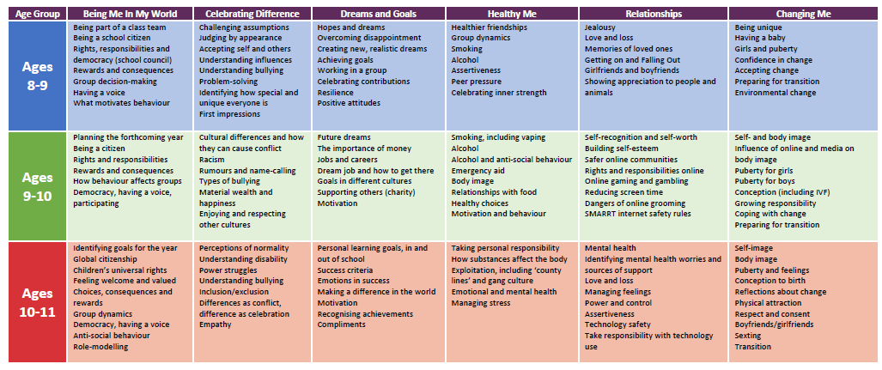
Jigsaw is a progressive scheme, with each unit being built upon year on year, so that the children become very familiar with the main topic strands and format of each lesson.
Notes:
As children develop in age, so to does the content of what they learn. All lessons are delivered by the class teacher, in a calm manner, with children free to ask questions and discuss the topic openly with their peers and friends.

Slide 12
What Does the Relationship Curriculum look like at SMRP?
Our ‘Relationships curriculum’ gives our children the information needed to develop healthy, nurturing relationships of all kinds. It also develops a child’s ability to keep themselves safe from harm and to know who to reach out to if help is needed.

Slide 13
What Does the Relationship Curriculum look like at SMRP?
Cyber safety and social networking
Safeguarding and keeping safe
Grief cycle
Families
Friendships
These topics are covered through the Relationships curriculum.
Roles and responsibilities in families
Stereotypes
Love and Loss
Own strengths and self-esteem
Attraction
Conflict
Communities
Assertiveness
Memories

Slide 14
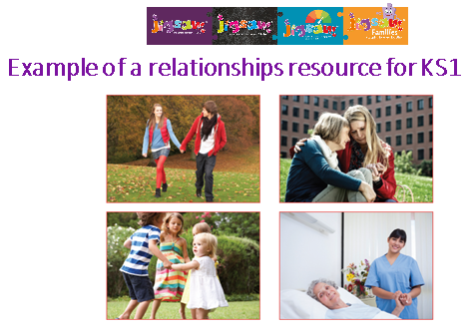
Jigsaw uses lots of photos to engage the children and encourage discussion. Here are some examples of the types of images used within Years 1 & 2 when thinking about different types of relationships.

Slide 15
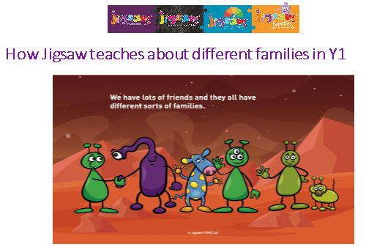
One aspect of the Relationships curriculum is to look at the varied and different types of family units within our community. The purpose is for children to develop a good understanding of the characteristics of healthy positive family relationships.
In this exercise the children begin to look at different types of families on the planet Zarg including those with adopted or fostered children, single parents, same gender parents etc.
Notes:
This is preceded by a matching game where children identify different animal families. After the children draw and label their own family. Same gender families are simply explained as those with 2 mums or 2 dads.

Slide 16
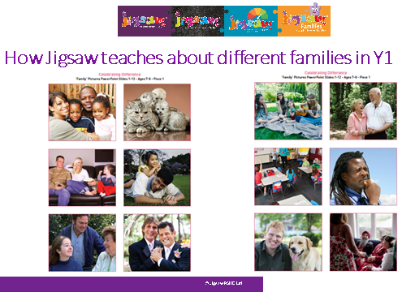
They then move on to looking at real images of a range families. Children then discuss within their groups and come up with a definition ‘A Family is…’
Same gender families are not taught in isolation – just as another family type.
Notes:
The lesson notes also help challenge stereotypical families and encourage children to think about other types of family that are not represented e.g. military families, adoptive families.

Slide 17
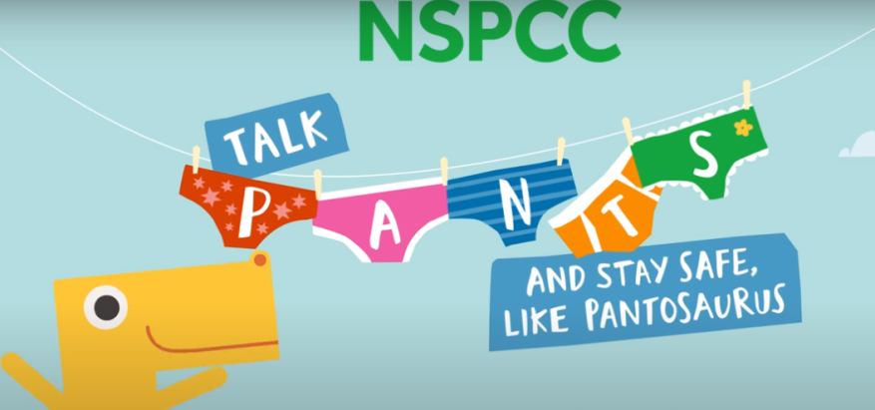

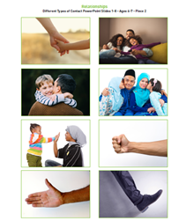
Keeping safe and understanding inappropriate and appropriate touch is taught alongside the NSPCC Pants material in EYFS and Years 1&2.
Notes:
In Jigsaw the children will play games involving communication and touch and children will have lots of opportunities to say how they personally feel about different types of touch – like hugs; high fives; holding hands; etc.

Slide 18
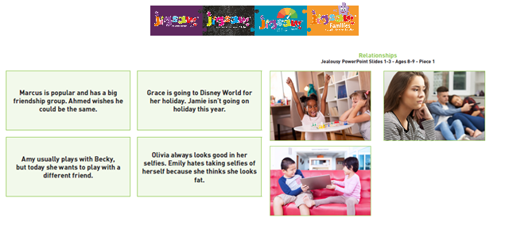
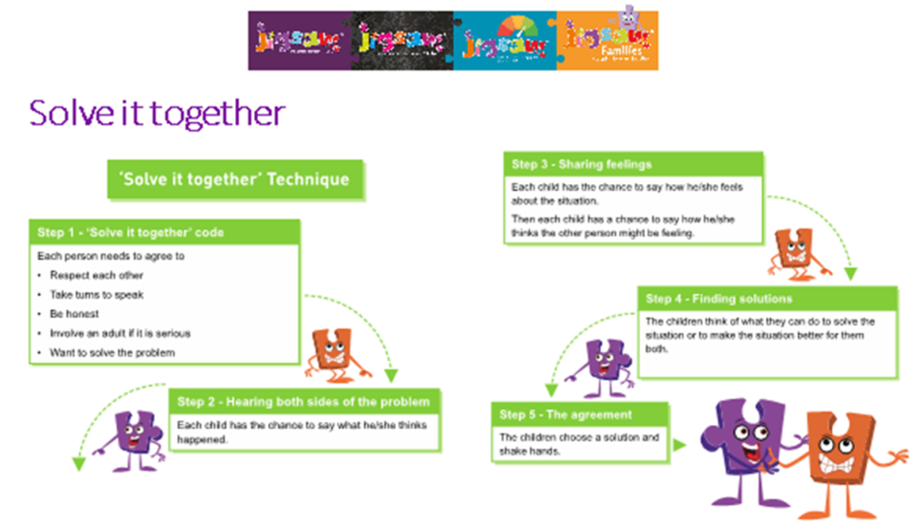
Relationship skills are built and enhanced through Jigsaw.
Notes:
Discussions about friendships, as well as disputes and jealousy are explored. Skills to identify how our emotions change and how are bodies feel during these times are also discussed.
Children also learn conflict resolution strategies, such as ‘Solve-it-together techniques’ using role-play and scenario cards.

Slide 19
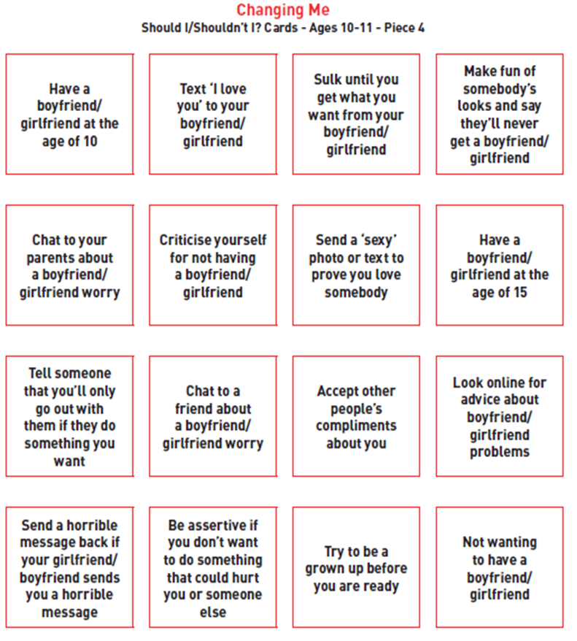
In upper Key stage 2, children begin to look at topics such as ‘boyfriends and girlfriends’.
They use scenario cards to discuss what they should or shouldn’t do.
Notes:
They also have an opportunity to explore why people have romantic relationships when they are older

Slide 20
What Does the Health Curriculum Look Like at SMRP?
SMRP’s ‘Health curriculum’ gives our children the information they need to make good decisions about their own health and wellbeing. It allows them to see and understand the connection between physical health and mental wellbeing being interlinked. In addition, children develop the skills to become confident in their ability to achieve and persevere.
Puberty is also taught through our health curriculum so that both boys and girls are aware and understand the changes that their bodies will experience.

Slide 21
What Does the Health Curriculum Look Like at SMRP?
Healthy eating and nutrition
Healthy safe choices
Cleanliness and hygiene
Changing bodies
Keeping safe online
Medicine safety
puberty
These topics are covered through the Health curriculum.
Smoking, drugs and alcohol
Body image
Motivation and behaviour
Healthy relationship with food
Healthier friendships
Exercise and wellbeing
Managing stress
Exploitation
Road safety

Slide 22
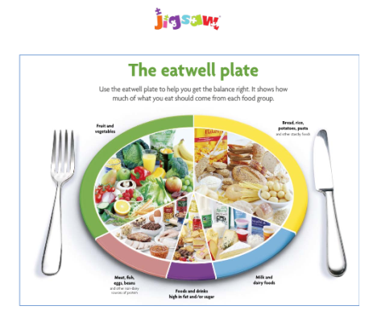
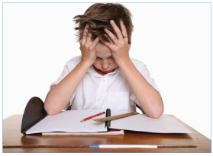
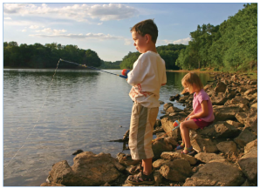
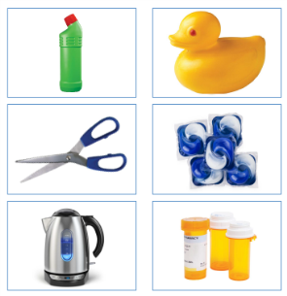
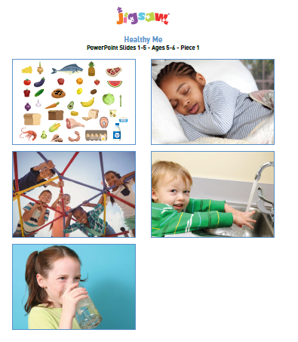
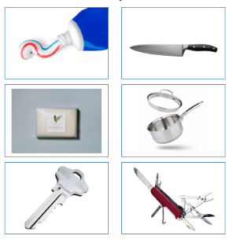
What Does the Health Curriculum Look Like at SMRP?
The focus in EYFS and Key Stage 1 is on healthy eating; exercise; stress and relaxation; hygiene and safety – such as road safety and medicines and household item safety.
Notes:
Images and scenarios are used as starting points for discussion. Children then have opportunities to draw, plan and write their ideas.

Slide 23
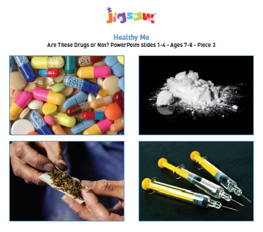
ask the children to draw the bag and the drugs inside. When they have finished, if appropriate, ask them to write some words next to their picture to explain what they have drawn.
ask the children to draw a picture of who they think this bag belongs to, followed by some words to describe them if they like.
ask the children to draw a picture of what the person whose bag it is was going to do with it. The children can write some words to explain.
ask the children to draw a picture of what the children do with the bag.
Notes:
This is an example of a lesson tackling the issue of drugs in lower Key Stage 2. In this lesson, children are read a scenario involving two children finding a bag containing drugs. At various points in the story children are encouraged to draw images and finally think about whether drugs are good or not and what they would do if this happened to them
1. Can a drug be good for you? If you think the answer is ‘yes,’ can you draw/write an example of a drug being good for you? If you think the answer is ‘no’, draw/write why not.
2. What would you do if you found a bag with drugs inside it? Draw and/or write what you would do.

Slide 24
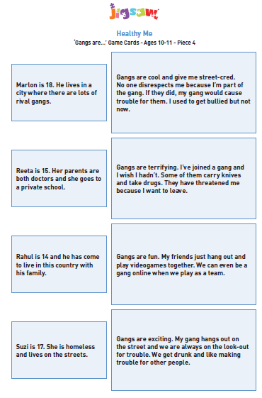
In this lesson for upper Key Stage 2, the children explore what a gang is and the reasons behind why people choose to join them.
Notes:
Children work in groups to match the cards, with no right or wrong answer, thus allowing children an opportunity to think about their reasons for their choices.
This gives an opportunity for teachers to dispel stereotypes and further discuss these stereotypes and where they come from.

Slide 25
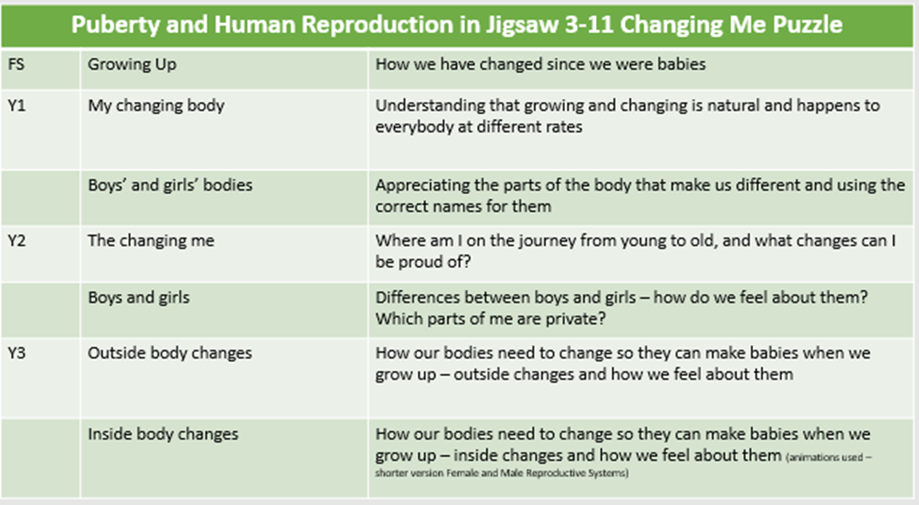
Puberty lessons
From EYFS onwards, each year group will have 2-3 lesson to learn about the physical changes in their body and in later years learn about the changes during ‘puberty’.
This table maps out the areas covered in each year.

Slide 26
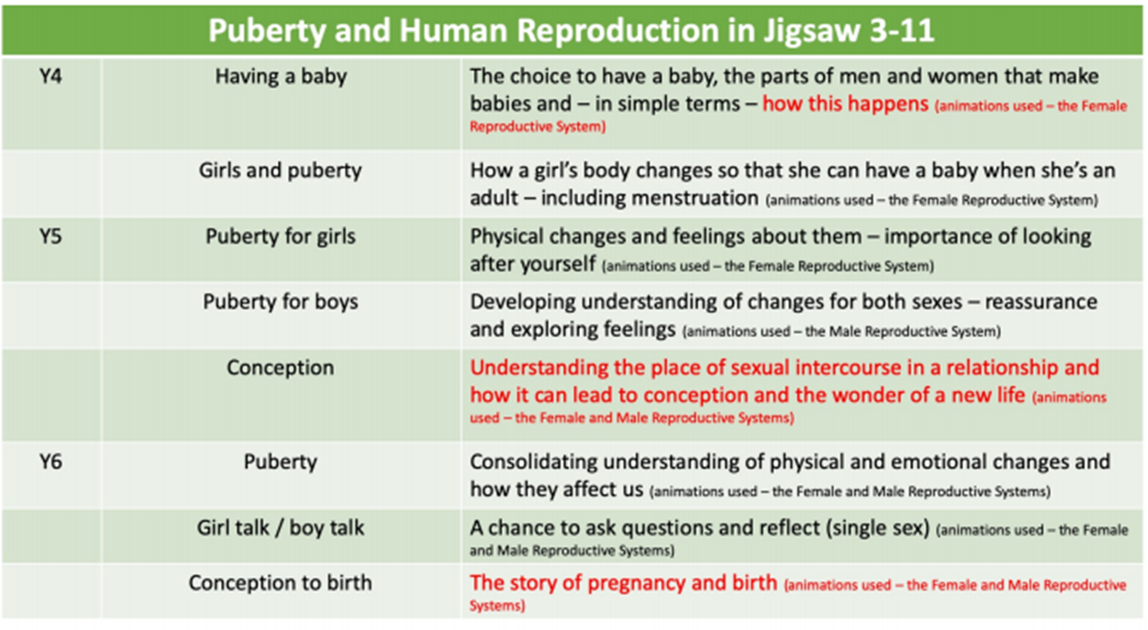
Puberty lessons
This table maps out the lessons for Year 4 to 6. The wording in red relates to the ‘sex education curriculum’. These lessons will be looked at further in the presentation.

Slide 27
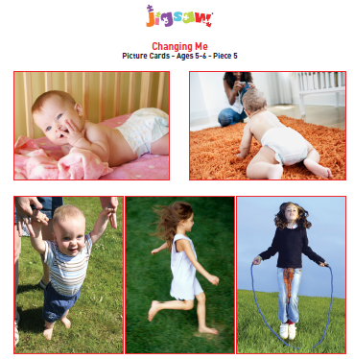
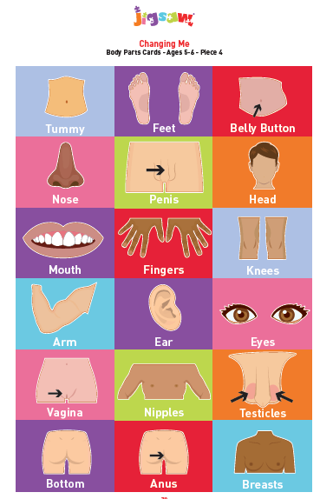
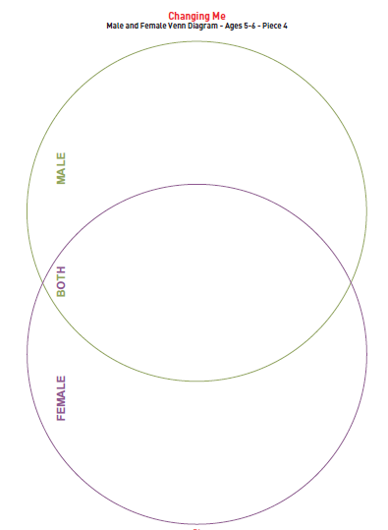
Changes and Puberty lessons
In Years 1&2, children discuss the changes from when they were a baby and how those changes will continue.
Notes:
They also learn the scientific names for the body parts and sort these through discussion. Children learn what is appropriate and inappropriate when it comes to our private parts (using the NSPCC Pants material). This allows them an awareness of how to keep themselves safe from an early age.

Slide 28
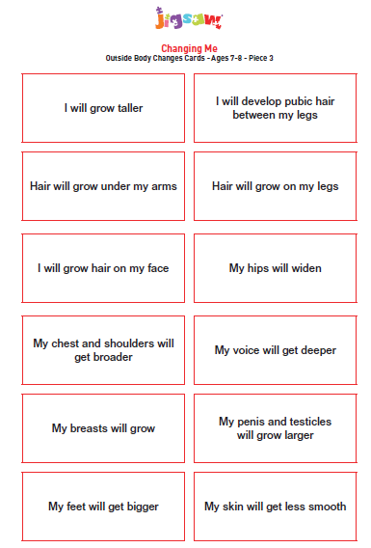
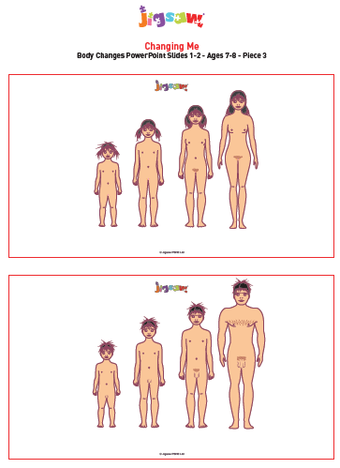
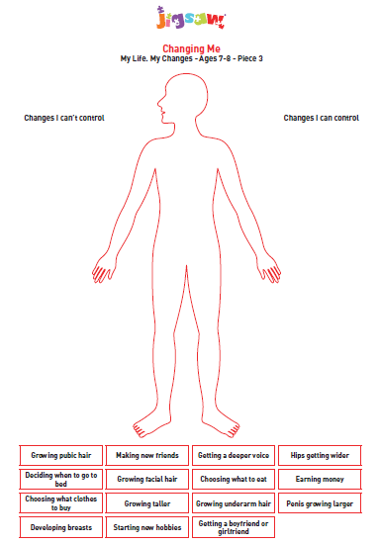
Puberty lessons
The early changes of puberty are introduced in Year 3. The children will begin to learn about these changes and have opportunities to talk about them.

Slide 29
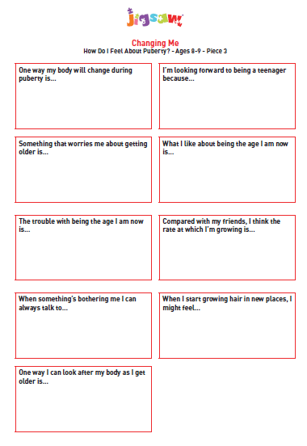
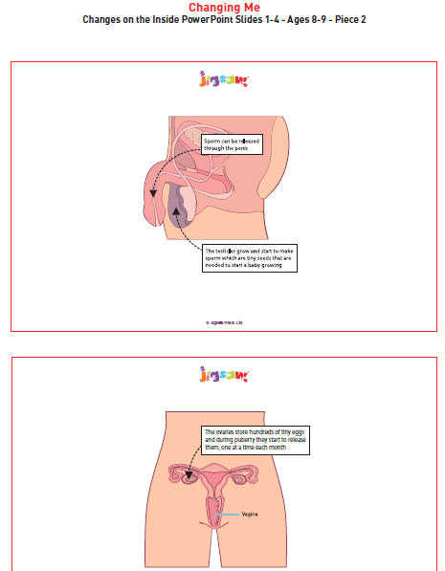
Puberty lessons
In Year 4, children begin to think about the changes that their bodies are beginning to or are going to experience.
Notes:
Lessons start with an open discussion about the fears and hopes the children have about growing up. They will start to learn about the internal changes within their genital area.

Slide 30
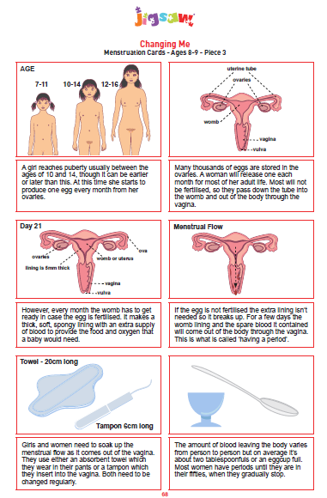
Puberty lessons
The lesson then moves on to looking at the female menstruation cycle. These cards are used to explain the cycle in a clear way.
Notes:
This lesson is delivered to all children together so that there is a shared understanding and any stigma associated with the menstruation cycle can be addressed.

Slide 31
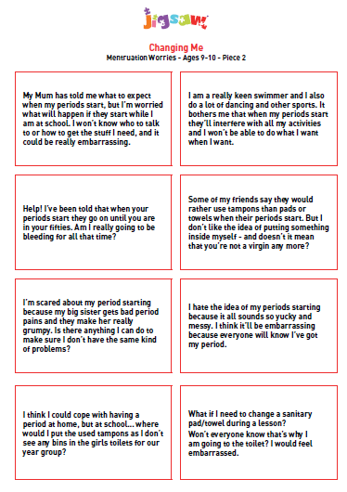
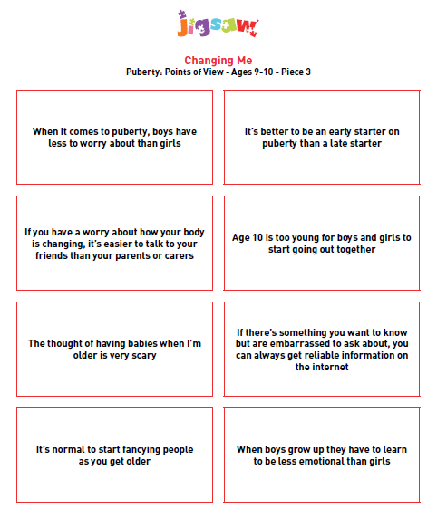
Puberty lessons
In Year 5, the children have an opportunity to review their thoughts, feelings and fears of menstruation. They also discuss the differences between boys and girls during puberty.

Slide 32
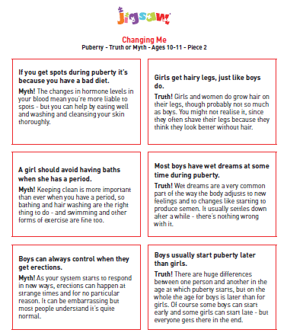
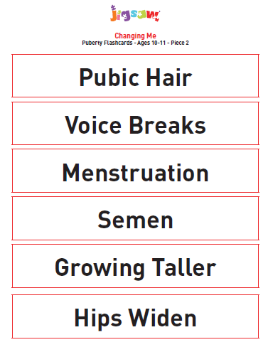
Puberty lessons
In Year 6, children look further into the other body changes that occur and learn the correct terminology for these changes.

Slide 33
What Does the Sex Education Curriculum Look Like at SMRP?
SMRP’s ‘sex education curriculum’ allows children to develop a scientific understand of conception and fetal development.
Animations and animated drawings are used during these lessons.
Children in Years 4 to 6 will receive between 1-2 sex education lessons a year.

Slide 34
What Does the Sex Education Curriculum Look Like at SMRP?
The wording in red outlines the areas covered in the ‘sex education curriculum’. These lesson begin in Year 4 and the knowledge is built upon in the subsequent years.

Slide 35
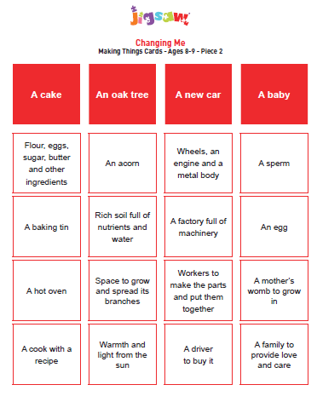
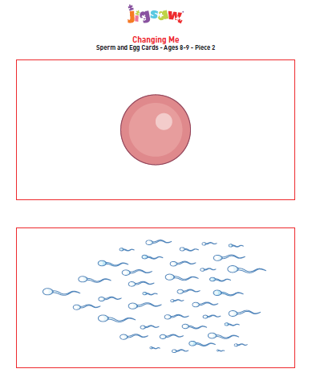
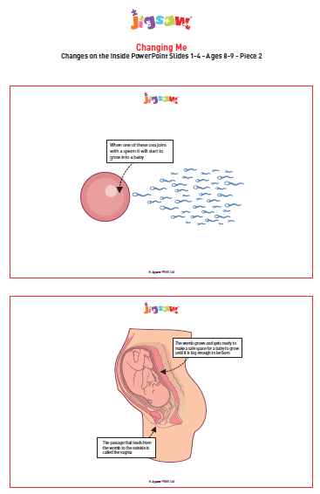
What Does the Sex Education Curriculum Look Like at SMRP?
Conception is introduced age appropriately in Year 4 in the context of why our bodies change linking it to puberty.
Notes:
Children learn that there are ingredients needed to create a baby. Teachers will use a scripted story to explain how the egg is fertilised by the sperm leading to conception.

Slide 36
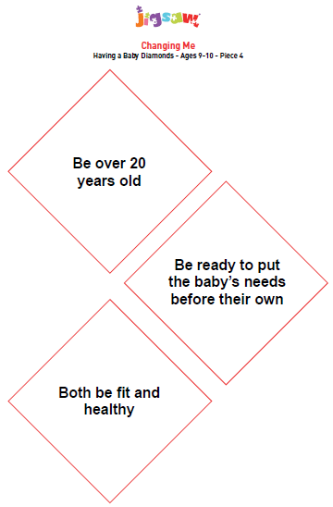
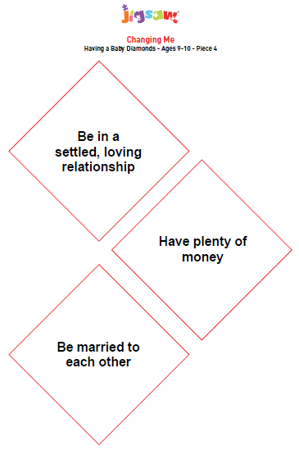
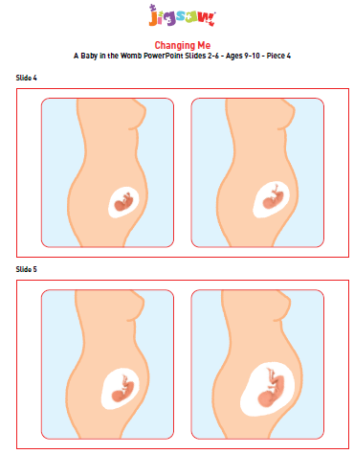
What Does the Sex Education Curriculum Look Like at SMRP?
In Year 5, the children review their previous knowledge from the year before and link this to ‘positive, healthy, loving relationships’, when thinking about why and when a couple may choose to have a baby.
Notes:
Children begin to learn the term ‘sexual intercourse’, as well as other methods of conception such as IVF. They also begin to learn about the development stages of the fetus.

Slide 37
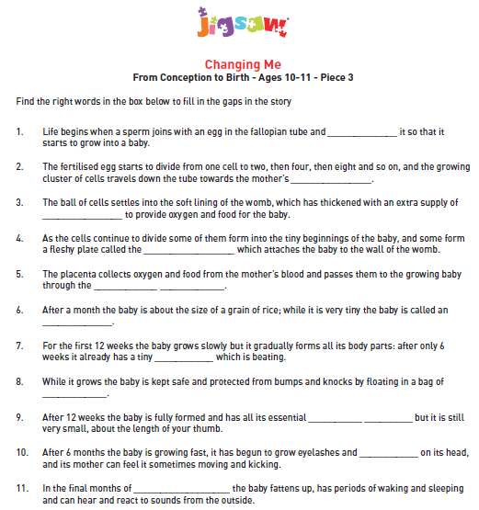
What Does the Sex Education Curriculum Look Like at SMRP?
In Year 6, the children develop a greater understanding of the journey from ‘conception to birth’. They are taught how to use the correct terminology and vocabulary.

Slide 38
Rights of a Parent/Carer
As mentioned at the start ,the Department for Education changed the status of the Relationship and Health curriculum making it compulsory for ALL pupils within state schools. This means that all children can not be withdrawn from the delivery of these lessons.
Parents and carers do however have the right to withdraw their child(ren) from sex education lessons being taught in school.
Sex education lesson are taught within ‘The Changing Me’ strand of the Jigsaw scheme. Parents and carers will be made fully aware of when these lessons are to take place.
Parents and carers are asked to inform the school via email if they wish for their child(ren) to be withdrawn from these lessons. Any child not attending these lessons will remain in school and be given alternative work to do by their class teacher.

Slide 39
Commonly Asked Questions and Misconceptions
Will the school have to consult with the parents and carers before delivering the RSHE curriculum?
Due to the changes in the status of the ‘RSHE curriculum’, all schools are required to consult with parents and carers when developing and reviewing their RSHE policies. This consultation will inform the school’s decision on when and how certain content is covered and delivered.
Notes:
Time will be given for parents and carers to input, ask questions and share their concern. The school will listen to parent and carer’s views, and then make a reasonable decision as to how they wish to proceed. What is taught, and how, is ultimately a decision for the school and consultation does not provide a parental veto on curriculum content.

Slide 40
Commonly Asked Questions and Misconceptions
Does the new Relationships Education curriculum take in to account my faith?
The DfE states that the Relationships Education has been designed to help children from all backgrounds build positive and safe relationships, and to thrive in modern Britain – this means taking into account the religious background of pupils when planning teaching, so that topics are appropriately handled.
Notes:
In developing these subjects, the government has worked with a number of representative bodies and faith organisations, representing all the major faith groups in England. Several faith organisations have produce teaching materials that schools can choose to use.

Slide 41
Commonly Asked Questions and Misconceptions
Will my child be taught about Lesbian, Gay, Bisexual and Transgender (LBGTQ+) relationships?
We believe that all pupils should be taught about the society in which they are growing up in. Relationships Education is designed to foster respect for others and for difference and to educate pupils about healthy relationships.
Children will learn that there are different types of loving, healthy relationships and family units. Equal weight and value will be given to all groups including LBGT+; foster; adoptive; religious and single parent families. No group will be taught in isolation.

Slide 42
Commonly Asked Questions
How do I know what is being taught in my child(ren)’s year group?
Yearly meeting will be held with the teachers from each year group prior to the RSHE lessons. Parents and carers will have an opportunity to view the material to be used and ask questions.

Slide 43
What Next?
This is the initial start of our consultation with you our parent and carers. There will be a questionnaire following on from this presentation to allow you to share your views and opinions on the changes to the RSHE curriculum and the content of the Jigsaw scheme.

Slide 44
Thank You for Coming to this Meeting

