Slide 1
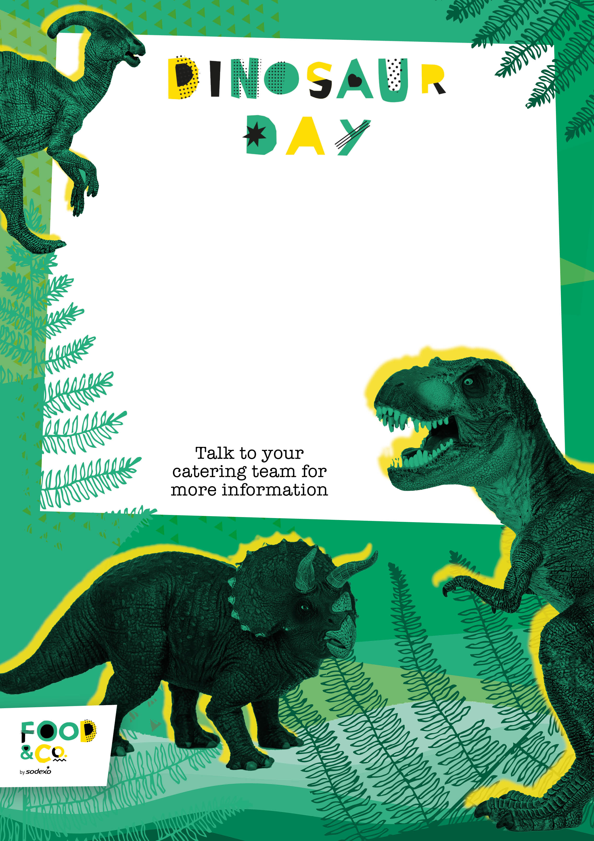
Thursday 18th January 2024
Veggie-Saurus Pasta Pesto
Dinosaur Dippers (Quorn)
Served with
Brontosaurus Baked Wedges & Pterodactyl Peas
Herrerasaurus Hot Cheese & Tomato Baguette
With Crudites
Bronto Biscuits
Or
Ferocious
Fruit Salad
Jackets Available

